Slide 1

Flow control strategies to mitigate boundary layer separation

Slide 2
Team Members:
Surendra Prasad
Aryan Gautam
Aatif Hasan
Gorre Kartik
B Anirudh
Ajay Singh
Group: 05

Slide 3
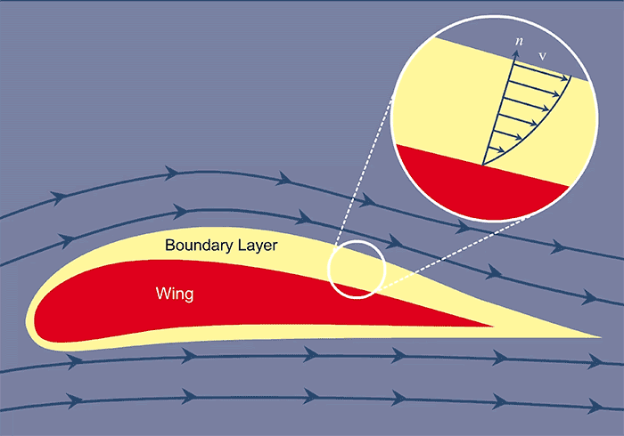
What is Boundary Layer ?
A fluid region adjacent to a solid surface where viscous forces dominate, velocity gradients are steep, and momentum exchange occurs, influencing drag, heat transfer, and flow separation transition.

Slide 4
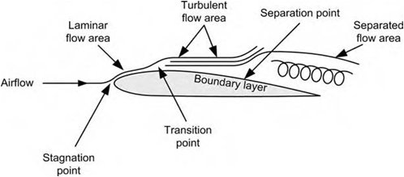
Why boundary layer separation matters?
Boundary layer separation reduces lift, increases drag, and causes flow instability, leading to poor aerodynamic performance, stall, and reduced control in aircraft.

Slide 5
How Separation Happens ?
Boundary layer separation happens when an adverse pressure gradient reduces momentum in the boundary layer halting its growth and causing the flow to detach.

Slide 6
Introduction:
Boundary layer separation reduces lift and increases drag. To counter this, passive and active flow control methods like vortex generators, suction, blowing, and plasma actuators etc. are used to maintain a thin, attached boundary layer.

Slide 7
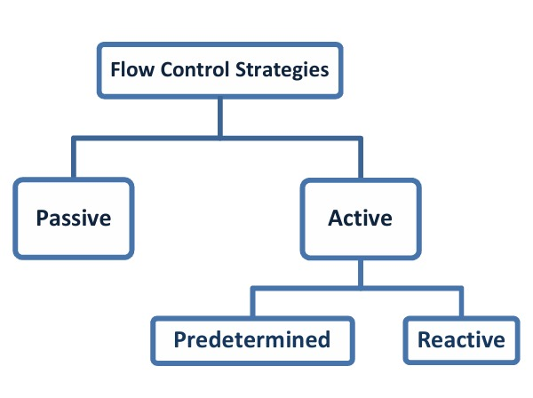

Slide 8
Active Method:
Active methods of boundary layer control involve energy input through techniques like heating walls, surface element movement, oscillatory blowing, plasma actuators, and synthetic jets to prevent separation.

Slide 9
Passive Method:
Passive methods of boundary layer control include techniques like vortex generators, distributed roughness, streamlining, and uniform blowing and suction, which do not require active energy input or controllers.

Slide 10
Suction and Blowing:
Suction is the act of extracting fluid from the boundary layer before the fluid separates upstream. Blowing is defined as entering fluid into the boundary layer in order to increase its momentum.
In the case of uniform blowing, the boundary layer momentum is increased by the injection of a high-energy fluid adjacent to the surface.
This blowing and suction flow control can be accomplished by uniform or an oscillatory process.

Slide 11
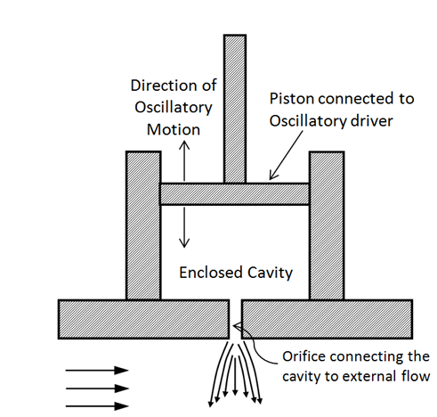
Some results from different papers:
A study over NACA 0015 showed that synthetic jet were strongly effective in increasing the lift coefficient which was more pronounced for larger jet amplitudes and at smaller angles of jet injection.
Zero net mass flux devices/ synthetic jets - flow control actuators that generate oscillatory fluid motion without net mass injection. These devices operate by periodically expelling and ingesting fluid through an orifice, creating vortical structures that enhance mixing, modify boundary layers, or control separation in aerodynamic systems
Oscillatory blowing and suction

Slide 12
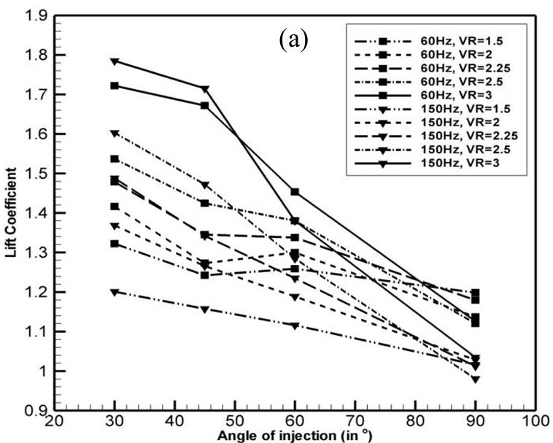

Slide 13
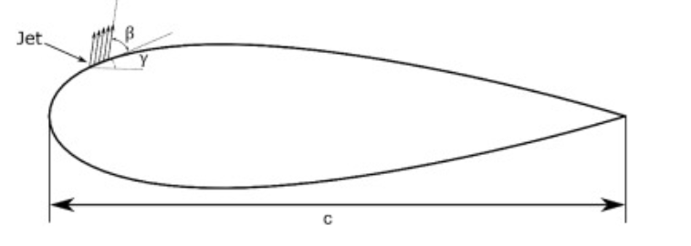
Physics behind it - The controlling aspect of a synthetic jets stems from the fact that it adds momentum flux and vorticity flux to the external flow, without any mass flux addition.
Synthetic jets can also be used as an active flow control method over wind and water turbine.
Net torque and power output of the turbine was improved by employing synthetic jets over airfoils, which increased the global efficiency of the turbine.
For the implementation of the synthetic jet, a simple boundary condition model was used. This model consists on imposing a uniform but time dependent velocity on the synthetic jet outlet.

Slide 14
When considering overall performance improvements, increases in turbine power of up to 38% were measured.
A numerical study was also done on synthetic jet where results showed that for attached flow, they caused early separation which declined the lift coefficient and for separated flow, enhanced the lift coefficient.
The primary advantage of suction is that it maintains the boundary layer attached to the surface, and consequently, drag decreases. The blowing, on the other hand, is much more sensitive, and in most cases, it reduces the aerodynamic performance.
The blowing at the leading edge increases the lift by producing additional vortices but causes pressure to significantly improve such that the boundary layer detaches from the surface, and therefore, drag increases.

Slide 15
Plasma Actuators
Boundary layer transition is the process by which laminar flow develops into turbulent flow. This is the fundamental concept of plasma excitation for controlling boundary layer transition.Plasma actuation is the controlled perturbation of a gas stream caused by the pressure, temperature, and physical properties of a plasma moving under the action of an electromagnetic field or by a gas discharge. The excitation of plasma
accelerates the boundary layer, resulting in a fuller mean flow velocity pattern and suppressing the growth of instability frequency caused by perturbations.

Slide 16
The experimental model is a super-zero-boundary airfoil with a chord length of 600 mm, a spread length of 500 mm, and an arc length of the upper airfoil of 615 mm. Plexiglass side panels are installed on both sides of the model to avoid the three-dimensional effect of the airfoil. The surface friction resistance is measured by surface oil droplet interferometry. Therefore, the surface finish is improved by covering the model with a glossy Mylar film.
The plasma actuator is positioned on the wing surface by using copper foil tape with a width of 8 mm and a thickness of 0.05 mm as the positive and negative electrodes.

Slide 17
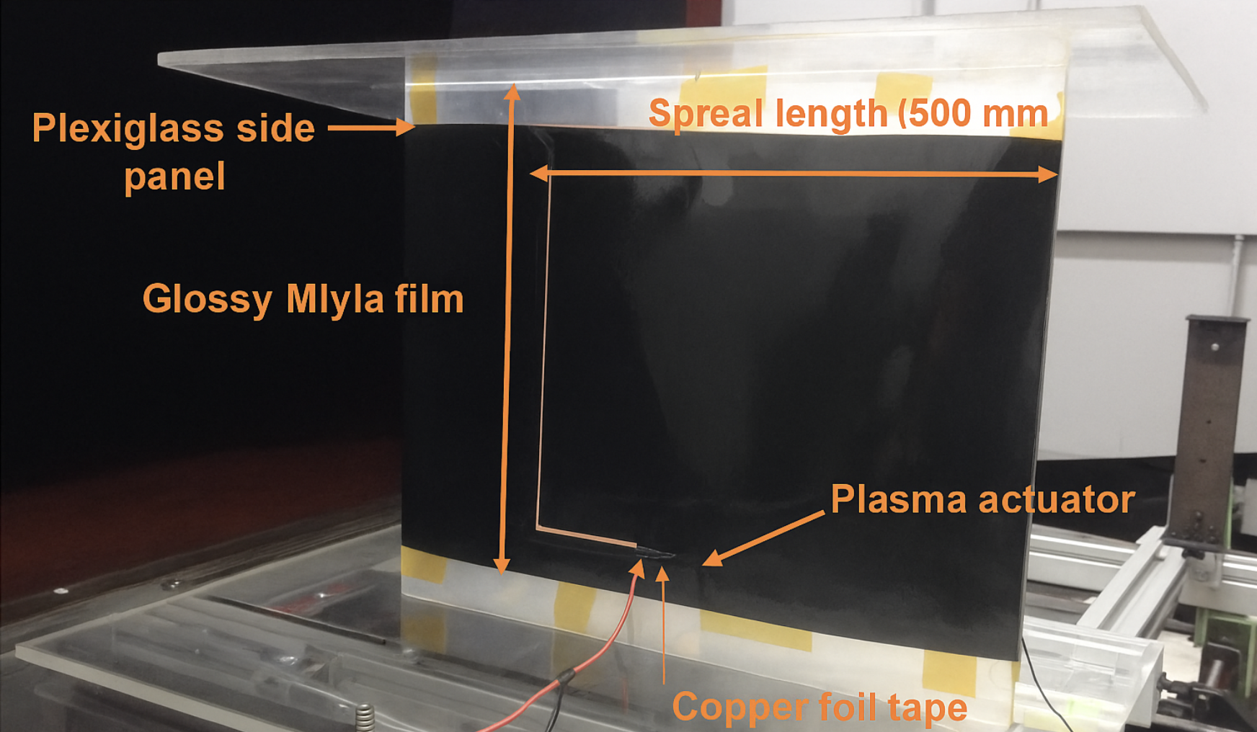

Slide 18
How to generate plasma
Various methods of generating plasma in experiments and industries are categorized as glow discharge, corona discharge, dielectric blocking discharge, atmospheric pressure glow discharge, RF corona discharge, microwave discharge.
The principle of plasma-delayed boundary layer transition under sub-transonic conditions involves the use of plasma and neutral particles to generate volume force in the aerodynamic boundary layer. This force is used to control and reduce boundary layer turbulence, preventing turbulence vortex systems.

Slide 19
Analysis of Experimental results
To determine the optimal actuator position, the natural transition position of the airfoil must be measured experimentally. The airfoil angle was fixed at 6°while varying wind speeds of 10 m/s, 15 m/s, and 20m/s were used to obtain the distribution of the natural transition position.
This experiment employed the oil droplet interferometric method to measure the distribution of surface friction coefficients of airfoils at various actuator discharge positions.

Slide 20
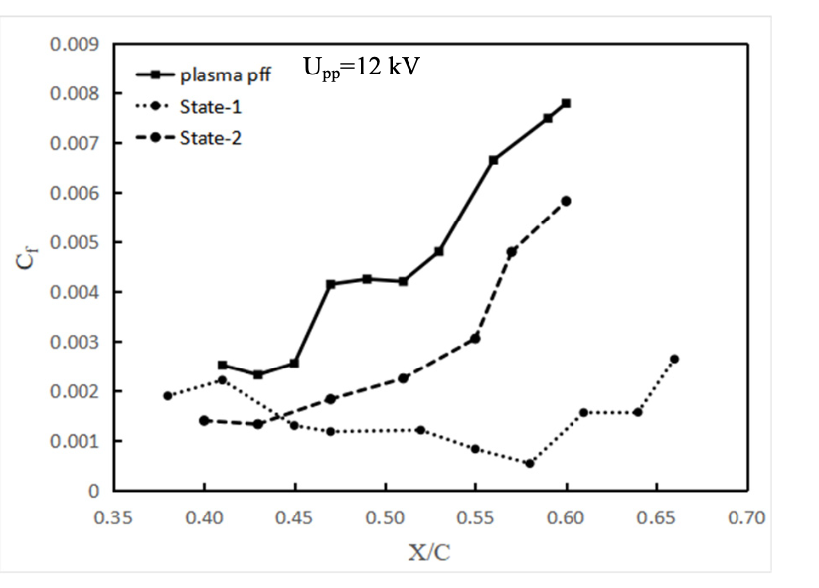
State 1, which represents the discharge positions x/c=0.2 and 0.27, and State 2,
which represents the discharge positions x/c=0.28 and 0.35. The figure shows that the efficacy of the plasma actuator in controlling the boundary layer through the jet is weakened when the discharge position is shifted forward. This suggests that there is a certain range of efficacy for the actuator and that the control effect will be weakened when it is far from the transition point.

Slide 21
Conclusions
The multi-stage plasma actuator was successfully utilized to control the transition of the low-speed airfoil and delay the boundary layer transition.
The position of the actuator has a significant impact on its control effect on the boundary layer. It is recommended that the actuator should be located at the upstream boundary layer transition zone to improve the energy efficiency of plasma control.
The continuous discharge plasma actuator can enhance the boundary layer stability and delay the transition by inducing the jet to inject momentum into the boundary layer.

Slide 22
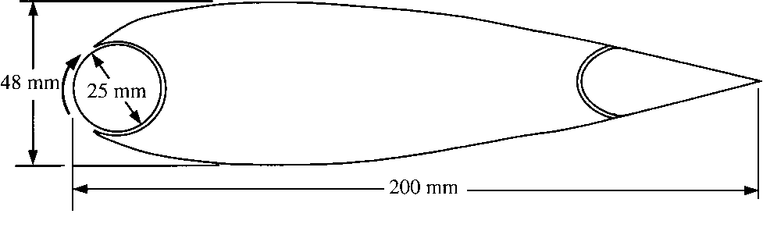
Leading Edge Rotating Cylinder
A rotating cylinder at the leading edge of an airfoil induces additional circulation which can significantly increase lift and delay stall.The experiment is done in a low speed tunnel on a NACA 0024 airfoil with a 25mm diameter rotating cylinder at the leading edge

Slide 23
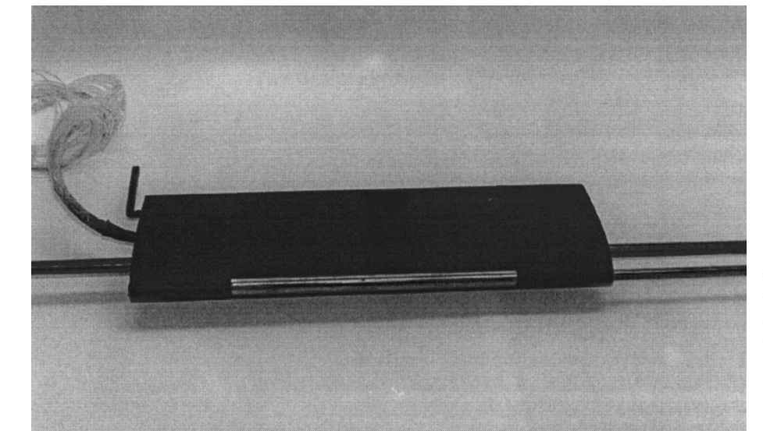
The cylinder rotation causes circulation due to which Magnus effect is induced around the airfoil as compared to circulation around the airfoil without the rotating cylinder.
Normal force acting perpendicular to the airfoil increases as the circulation induced by the rotating cylinder increases.
The increase in the normal force results in an increase in the lift and would not affect the drag as long as the angle of attack is small.
The pressures on the upper surface of the airfoil decrease while the pressures on the lower surface increase generating higher lift.

Slide 24
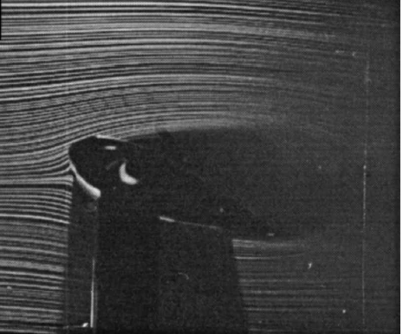
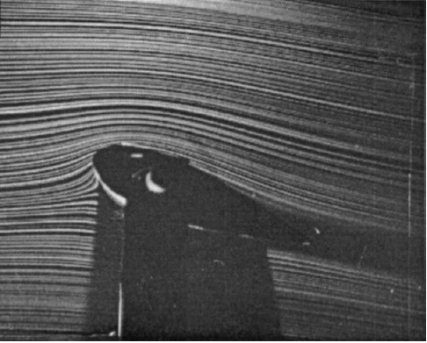
Key Results:
Maximum lift coefficient (CL) rises from 0.85 (Uc/U = 0) to 1.63 (Uc/U = 4), an increase of ~92%
Stall angle of attack increases from ~10-15 (Uc/U = 0) to 30-35 (Uc/U = 4), a 160% improvement.
In absence of rotation the boundary layer has a thickness of 3 mm at x/c = 0.4 and grows to about 25 mm at trailing edge. whereas for Uc/U = 4, the boundary-layer thickness grows from 1.5 mm to 7.0 mm along the chord.
Uc/U = 0
Uc/U = 3

Slide 25
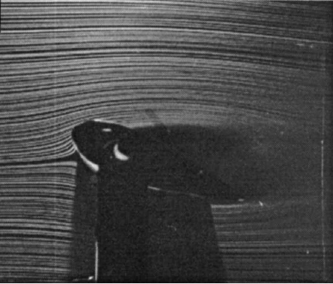
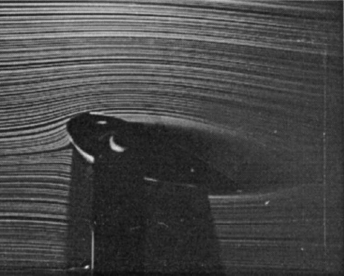
Uc/U = 0 (no rotation)
Uc/U = 1
Uc/U = 2
Uc/U = 3

Slide 26
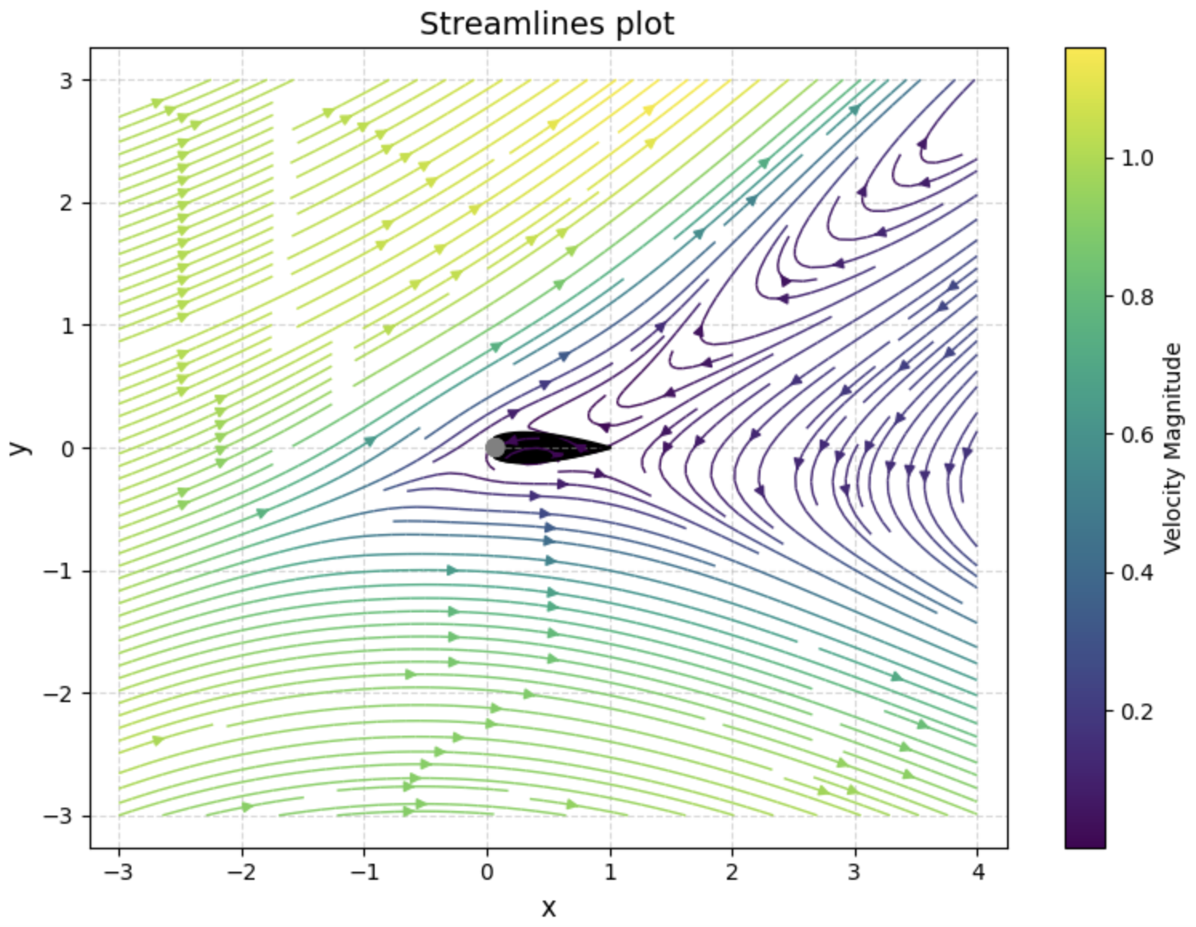
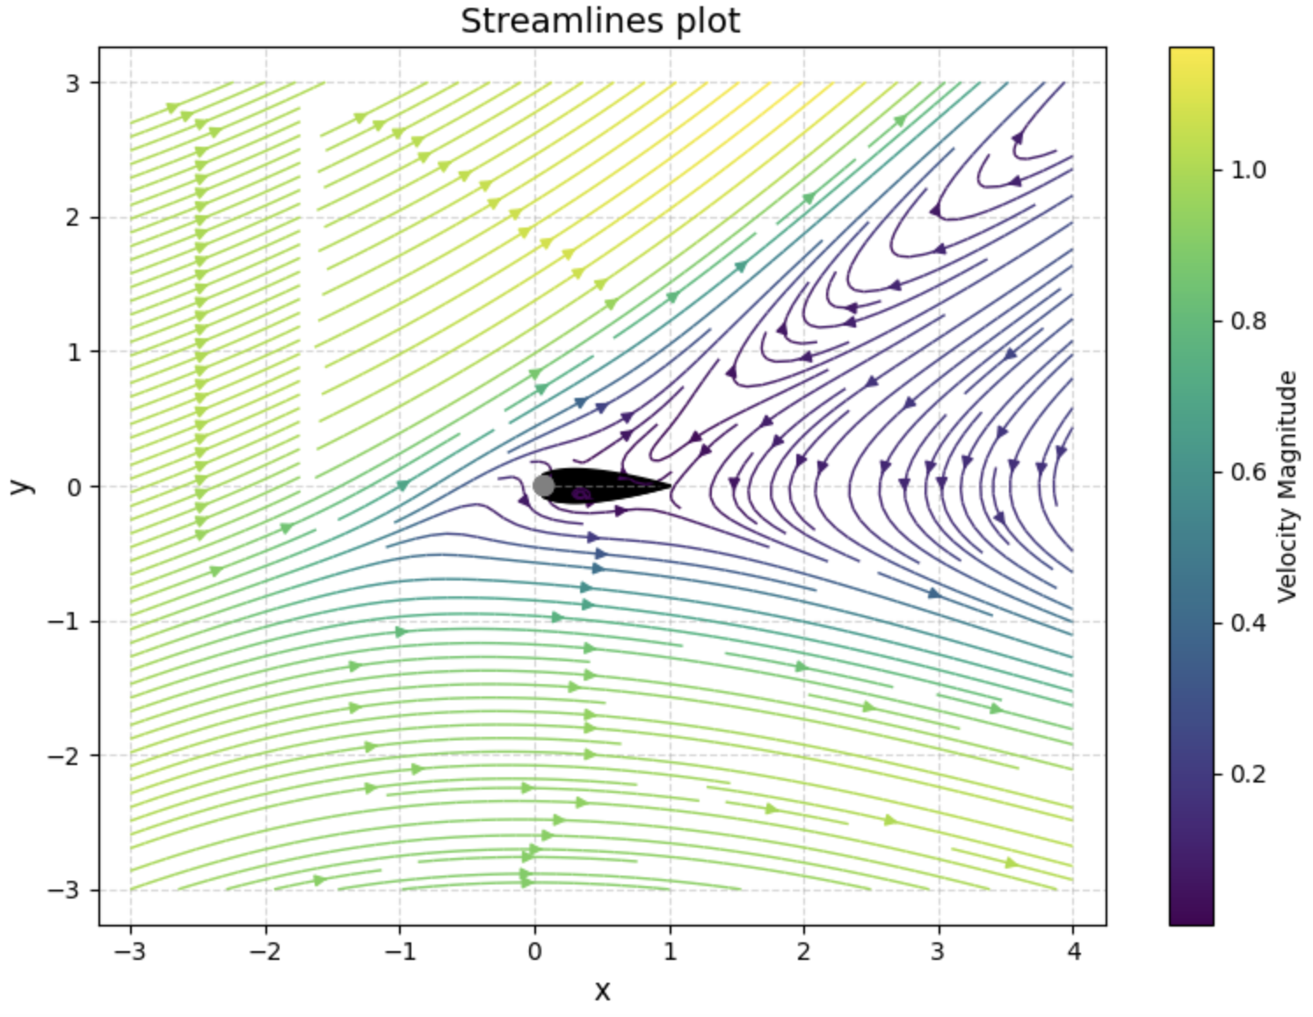
Coding
We tried to visualise the flow over airfoil with rotating cylinder using PINNs .
With deepxde , PINN architecture we tried to model the flow
Governing equations used - continuity , Navier stokes x & y momentum equations
Domain -Rectangular domain , Initial and boundary conditions over cylinder , airfoil surface and fairfield conditions were used .
Hyperparameters- 4 hidden layers with 30 neurons each , tanh activation fnc , adam optimizer with learning rate 10^-3.
We obtained the following stream lines plots for different cylinder angular velocities.
Uc/U = 0
https://colab.research.google.com/drive/13Ed2sDz-d57z4mCqK1Lowfd1AITWDpuO#scrollTo=e9d54d9a
Uc/U = 1

Slide 27
VORTEX GENERATORS
1. What Are Vortex Generators (VGs)?
Tiny fin-like devices placed on surfaces like wings, ducts, or fuselage.
They create swirling airflow (vortices) that:
Mix faster outer flow into slower near-wall flow.
Help keep the boundary layer attached to the surface.
Why is that important?
➤ Flow separation = more drag + less lift = BAD for aircraft performance.

Slide 28
2. What’s Special About Low-Profile VGs?
Conventional VGs Low-Profile VGs
Height ≈ boundary layer (h ≈ d) Height = 10%–50% of boundary layer (h <<d)
More effective but more drag Almost as effective, but MUCH less drag
Harder to integrate Smaller, stealthier, can be retracted
Used in modern aircraft design where:
Fuel efficiency matters,
Stealth is important (lower radar signature),
Surfaces need to stay clean (can be hidden).

Slide 29
3. What Did the Research Find?
At Low Speeds (e.g., drones, small aircraft):
1.Up to 90% reduction in flow separation using low-profile VGs (h/d ≈ 0.2). 2. Performed almost as well as conventional VGs but with significantly lower drag. 3. Most effective when placed 5–30 device heights upstream of the separation point. 4. Counter-rotating vanes produced strong but controlled vortices, leading to cleaner reattachment. 5..Delivered smoother pressure profiles with less 3D flow disturbance than larger VGs.
At High Speeds (supersonic flow):
1.Low-profile VGs reduced separation bubble height by up to 94% in supersonic flow. 2.Placing them 20–50 heights upstream of the shock allows vortices to energize boundary-layer flow. 3.Improved pressure recovery, especially in supersonic diffuser applications. 4.Outperformed passive cavities in separation control, though with slightly higher shock loss. 5.Ideal for high-speed systems where wave drag and flow separation are major concerns.

Slide 30
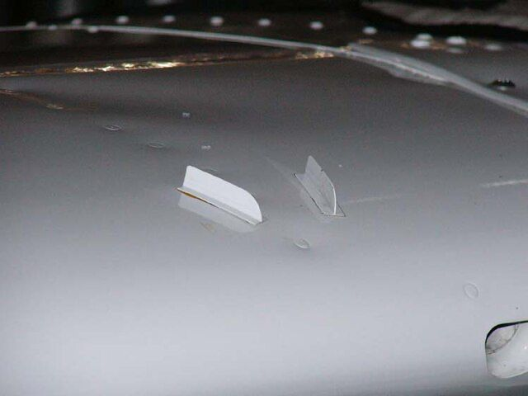
When can we use low - profile VGs?
They are typically best for being applied to applications where flow-separation locations are relatively fixed and the generators can be placed reasonably close (less than 100h) upstream of the baseline separation.

Slide 31
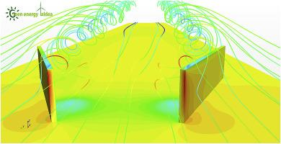
4. How to Use Them Best
Design Tips from the Paper:
Best placed 5–30 VG heights upstream of where separation happens.
Use counter-rotating spaced vanes (last longer, more effective).
Don’t make the vortices too strong — just strong enough to fix the flow

Slide 32
5. Where Can We Use Low-Profile VGs?
Application Purpose
Wings (low-Re, transonic, swept) Improve lift & delay stall
Gulfstream III noise fix Reduce cabin noise
Engine S-ducts Prevent inlet distortion
Overwing fairings (e.g. V-22 Osprey) Reduce drag, improve flow
Pressure recovery zones Boost aerodynamic efficiency

Slide 33
6. Key Takeaways
Low-profile VGs = small, smart flow-fixers.
Control separation with less drag, less weight, and better stealth.
Ideal for modern aircraft, from UAVs to fighters to commercial jets.
Simple solution with huge impact on aerodynamic performance.

Slide 34
References
Suction and Blowing: https://www.sciencedirect.com/science/article/pii/S0960148117304688
https://iopscience.iop.org/article/10.1088/1742-6596/822/1/012009/meta
https://iopscience.iop.org/article/10.1088/1757-899X/248/1/012009/meta
Plasma Actuators: https://iopscience.iop.org/article/10.1088/1742-6596/2730/1/012055/meta
Leading Edge rotating cylinder: https://www.researchgate.net/publication/245429665_Flow_Control_for_an_Airfoil_with_Leading-Edge_Rotation_An_Experimental_Study
Vortex Generators: https://www.sciencedirect.com/science/article/pii/S0376042102000106

